Slide 1

Bank Churn EDA and Machine Learning Project
Emmanuel Nnadi
Keadon Harrison
March 2024

Slide 2
Introduction
The dataset we chose to analyze contains synthetic customer data for a bank. The aim of this project was to accurately predict the amount of customers who are most likely to leave the bank. We chose this project because we both have backgrounds in the banking industry and we wanted our project to reflect that. We also wanted to solve a real-world business problem which we believe this project does.

Slide 3
Structure
Variable Exploration
Exploratory Data Analysis
Hypothesis
Machine Learning and Predictions
Conclusion

Slide 4
Variable exploration
Numerical Columns
Credit Score
Age
Tenure
Balance
NumOfProducts
EstimatedSalary
Mem_no_Products
Cred_Bal_Sal
Tenure_Age
Age_Tenure_Product
Categorical Columns
Surname
Geography
Gender
HasCrCard - Whether the customer has a Credit card
IsActiveMemver - whether the customer is active
Exited - whether the customer has churned

Slide 5
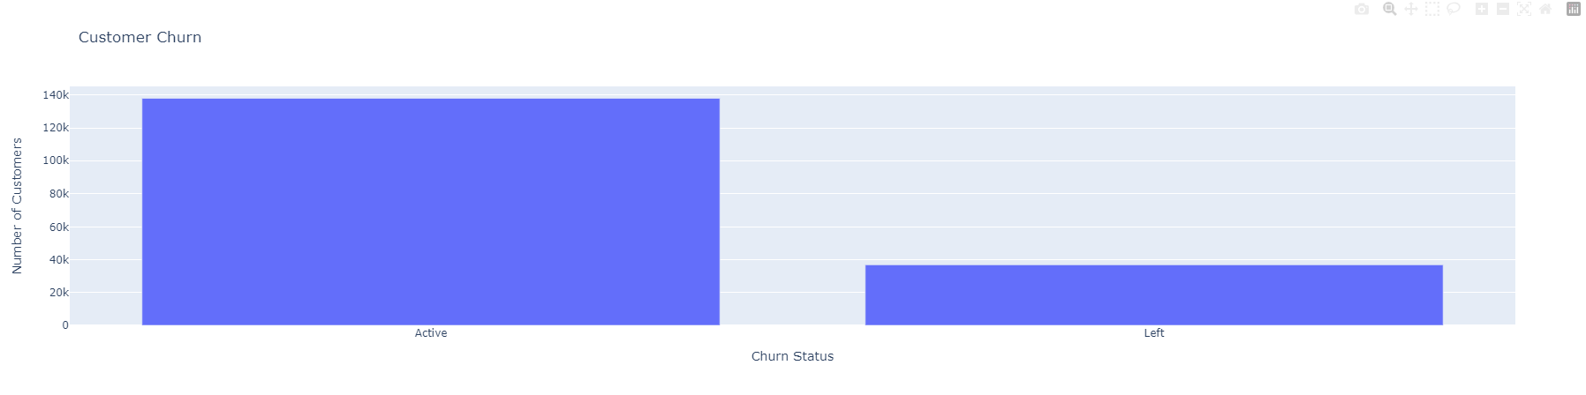
EDA - Visualization

Slide 6
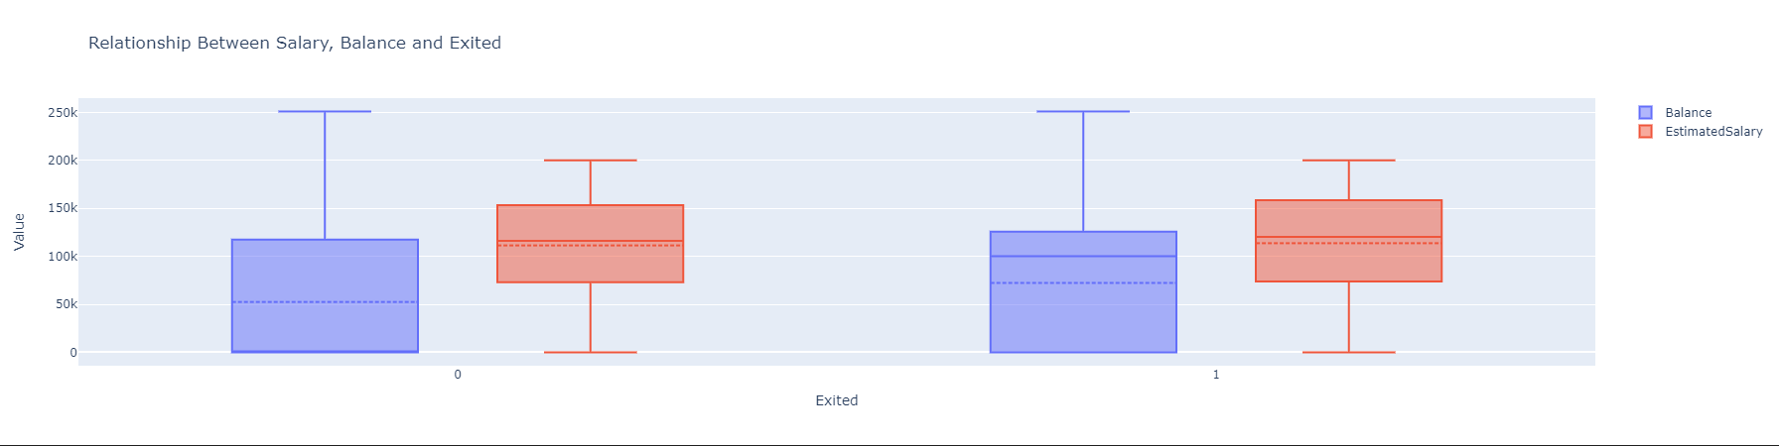
EDA - Visualization

Slide 7
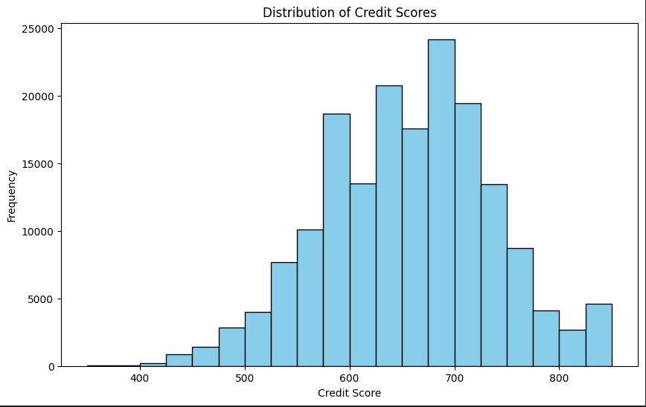
EDA - Visualization

Slide 8
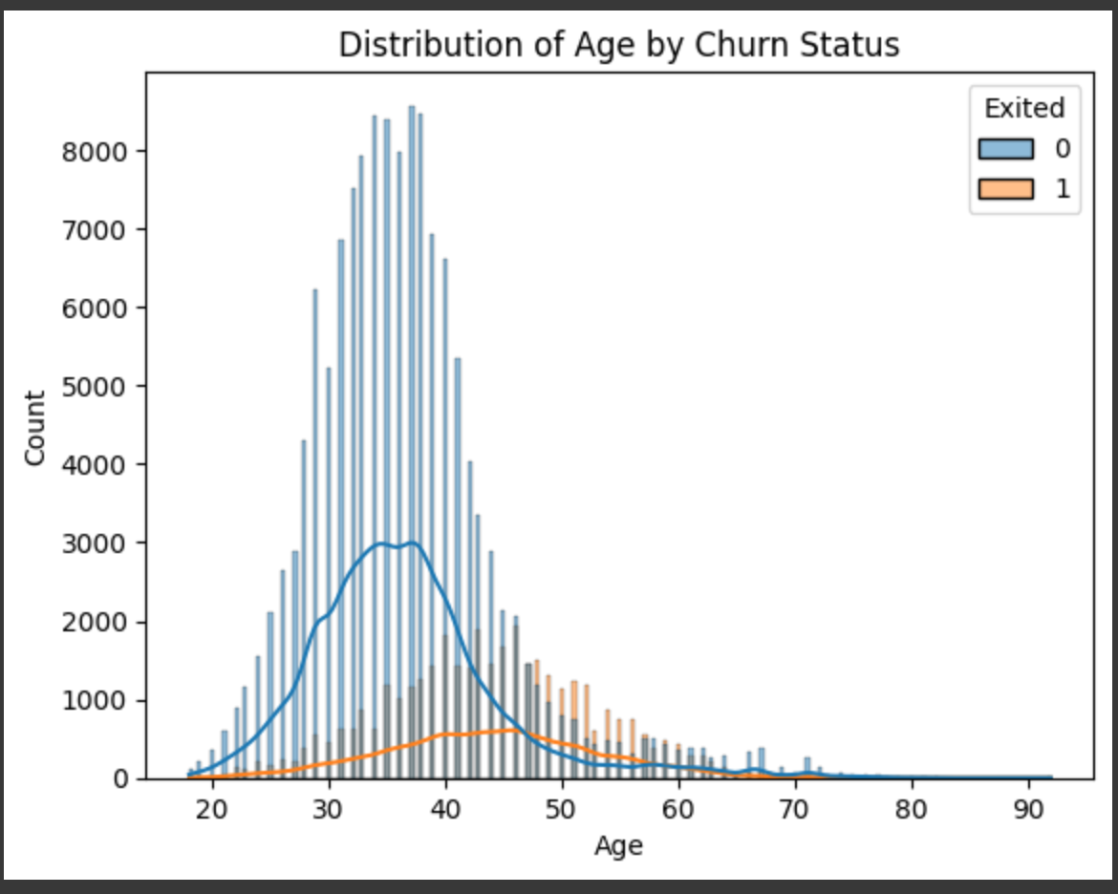
EDA-Visualization

Slide 9
Models Used
Logistic Regression
Random Forest
Decision Tree

Slide 10
Hypothesis
“Based of our data we believe that the model will factor in age as a major feature in the churn prediction. Leading to a conclusion that we need to address older clients concerns to retain them”

Slide 11
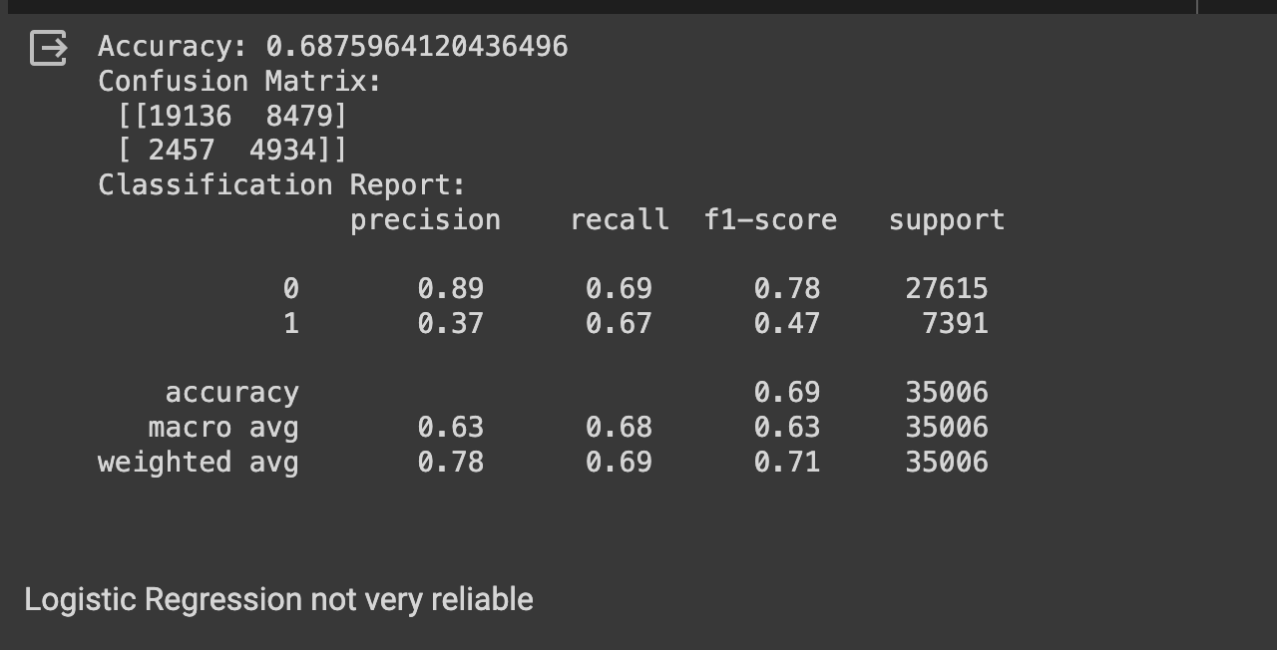
Logistic Regression Model Evaluation

Slide 12
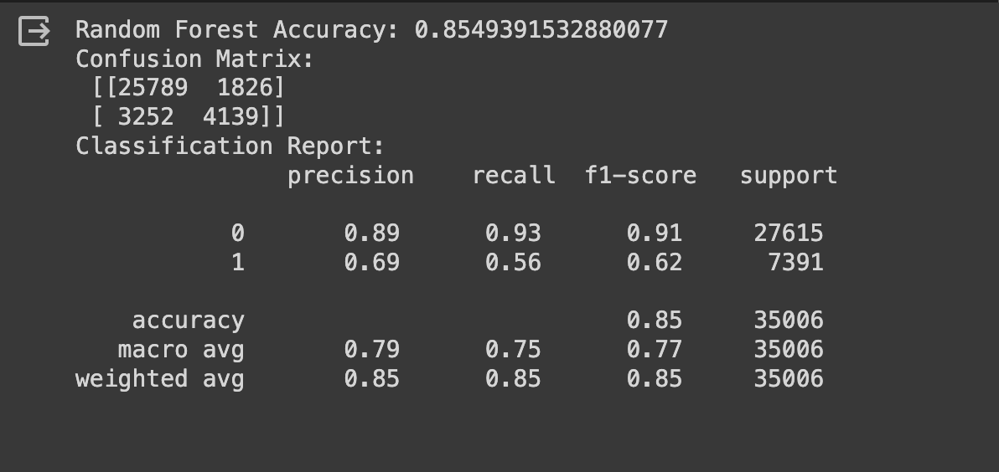
Random Forest (Original)

Slide 13
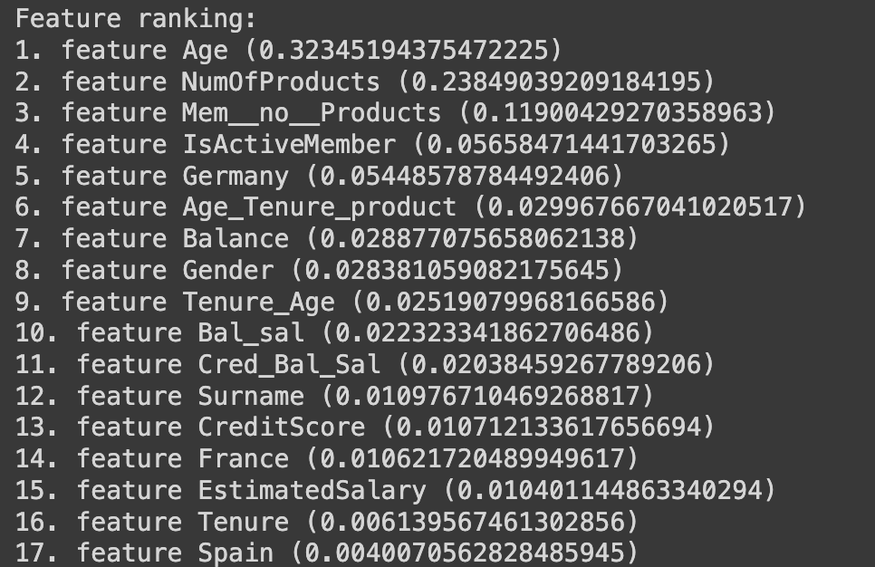
Feature Importance

Slide 14
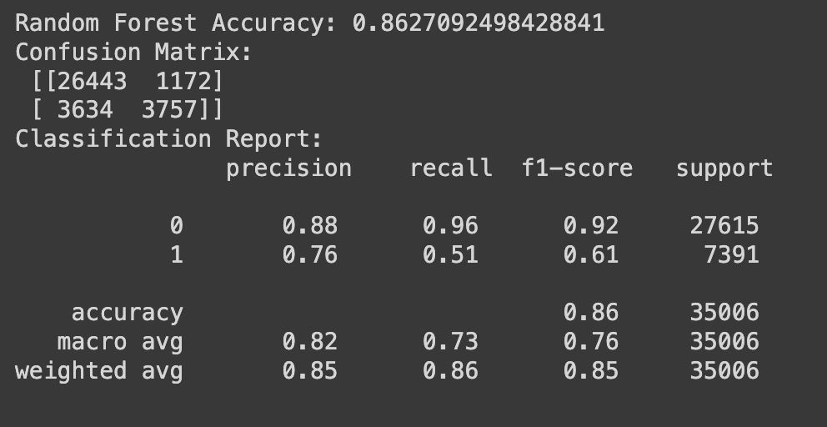
Random Forest Hypertuned and Feature Engineered

Slide 15
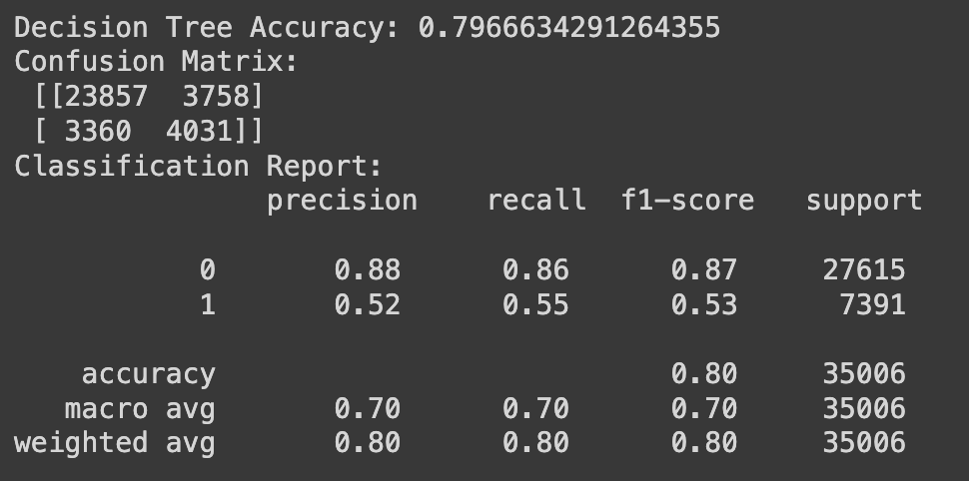
Decision Tree

Slide 16
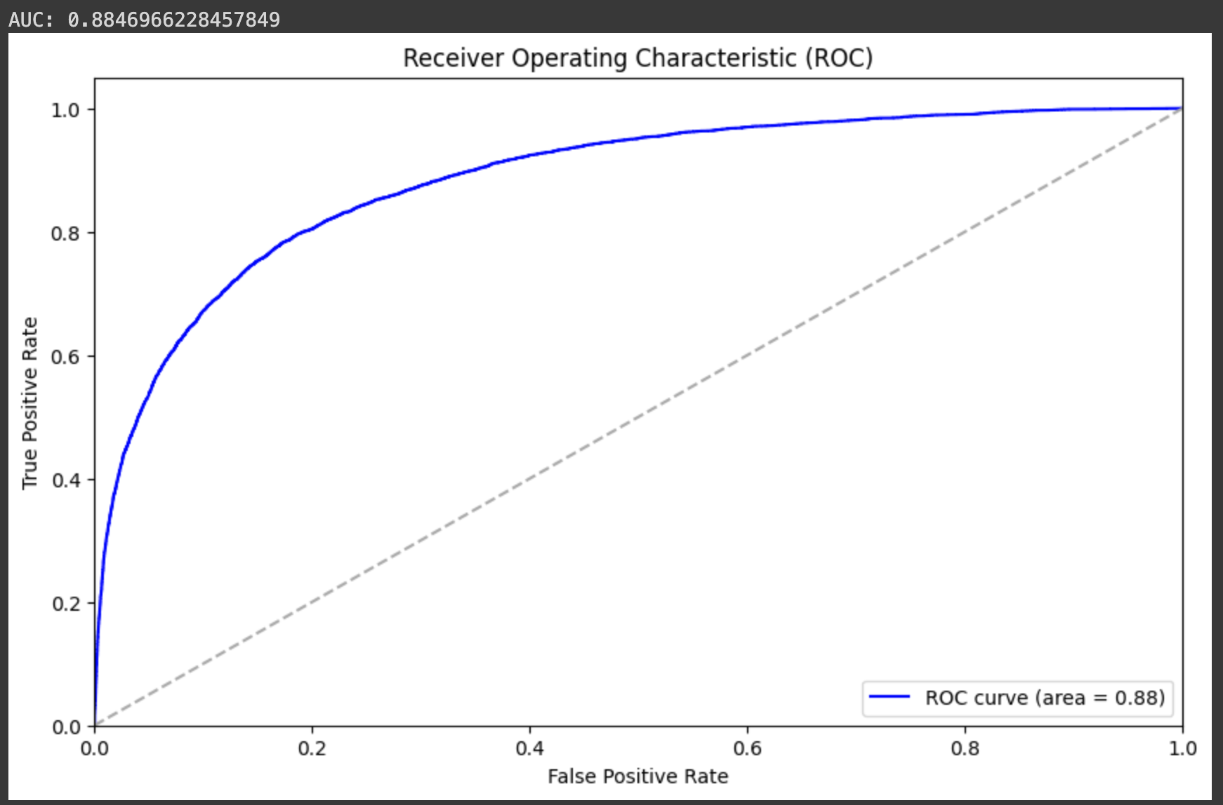
ROC

Slide 17
Conclusion
We decided to go with the Original Random Forest due to decent level recall for class 1 (Class 1 - Churned): 0.56 and a good accuracy Accuracy: 85.49%.
Since the major business concern is regarding churn.

